Slide 1
Workforce Development
Board
Fairfield Inn & Suites
Grand Island, Nebraska
January 9, 2017
Lisa Wilson, Chair
A proud partner of the American Job Center network.

Slide 2
Approval of
Minutes
Agenda Item
4. September 29, 2016 Minutes* - Pages 11-16

Slide 3
Request for Proposal (RFP)
Committee Recommendations
Agenda Items
6A. One-Stop Operator* - Page 23
6B. Adult & Dislocated Worker* - Page 23
6C. Youth* - Page 23
6D. Administrative Entity* - Page 23
Members
Ann Chambers
Stacey Weaver
Gary Kelly
Lisa Wilson
Stan Clouse – CEOB
Pam Lancaster – CEOB
Hal Haeker – CEOB

Slide 4
Strategic Planning
Committee
Agenda Items
6E. Regional Planning Schedule* - Page 30
6F. Financial Reporting Policy* - Pages 31-33
6G. Memorandum of Understanding - Pages 33-34
Members
Chris Callihan, Chair
Peggy Sandall-Bertrand
Dan Mauk
Roy Lamb II
Denise Pfeifer
Christina Thaut

Slide 5
System Coordination
Committee
Agenda Items
6H. Customer Satisfaction Surveys – Pages 38-40
6I. Oversight Policy* - Page 35
6J. Incentive Policy* - Page 36
6K. Quality Assurance Review - Page 37
Members
Stacey Weaver, Chair
Greta Kickland
Charlene Lant
Kelsey Miller
Ann Chambers
Elaine Anderson
Wayne Brozek
Gary Kelly
Jill Smith

Slide 6
Administrative
Entity
Agenda Item
6L. Monitor Review
Finding #1) WDB Oversight: The administrative entity should review the Oversight Procedure Policy and plan Board completion of the process. If there have been changes to the oversight procedures a revised policy or WIOA oversight plan is needed. The procedures should be published as an attachment to the local plan when the WIOA Plan is required by the State. (20 CFR § 679.270)
Corrective Action: The administrative entity has worked with the System Coordination Committee to update this policy and has created an attachment to the local area plan (Agenda Item 6I).

Slide 7
Administrative
Entity
Agenda Item
6L. Monitor Review
Finding #2) Allowable Cost and Accurate Reporting: Work Experience must have academic and/or occupational education component & Incentive Payments must be tied to the goals of the specific program, outlined in writing before the commencement of the program that may provide incentive payments; align with the local program’s organizational policies; and are in accordance with the requirements contained in 2 CFR part 200.
Corrective Action: The administrative entity has reviewed twelve (12) Work Experience enrollments since July 1, 2016 and is in the process of bringing eight (8) into compliance. Finance will be notified to make any needed adjustments for expenditures on youth that do not meet the twenty percent (20%) academic/occupational component requirement (Agenda Item 6K).
The administrative entity has worked with the System Coordination Committee to develop a revised incentive policy that meets the requirements found in 20CFR§681.640 (Agenda Item 6J).

Slide 8
Administrative
Entity
Agenda Item
6M. Reduction of FY17 Funding - Page 24
Adult Program: -$1,878
Dislocated Worker Program:-$2,973

Slide 9
Administrative
Entity
Agenda Item
6N. Transferring of Funds* - Page 37
Transfer $150,000 of Dislocated Worker funds to the Adult program with all funds coming from FY16 funds, effective 01/09/17.

Slide 10
Administrative
Entity
Agenda Item
6O. Finance & Performance Review - Pages 25-26
 | Current Funds Available in RRS As Of 12/08/16 | Expected Staffing Expenses Until 6/30/17 (6 months) | Current Obligation Total | Maximum Quarterly Obligation Per Participant OST | Projected Funded Participants for the quarter | Projected Quarterly Obligations | Projected Carry-in Funds for Next Quarter
Adult | $558,348 | $187,128 | $54,468 | $1,250 | 56 | $62,500 | $254,252
DLW | $1,017,749 | $141,030 | $122,478 | $2,500 | 51 | $127,500 | $626,741
Out of School Youth | $338,904 | $110,220 | $61,737 | $1,250 | 61 | $76,250 | $90,697
In School Youth | $193,598 | $19,446 | $9,892 | $2,000 | 15 | $30,000 | $134,260

Slide 11
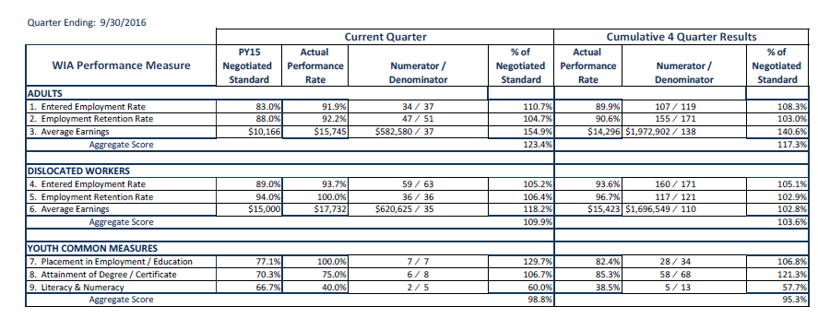
Administrative
Entity
Agenda Item
6O. Finance & Performance Review Pages 25-26

Slide 12
Agency Contacts
Meeting Schedules, Communication, & Expense Reimbursement |  |  |  | Wendy Sieler, Staff Assistant Office of Employment & Training Nebraska Department of Labor (402) 471-2565 wendy.sieler@nebraska.gov
Board Planning & Support |  |  |  | Dylan Wren, Program Coordinator Office of Employment & Training Nebraska Department of Labor (402) 471-9878 dylan.wren@nebraska.gov
Program Oversight |  |  |  | Shannon Grotrian, Administrator Office of Employment & Training Nebraska Department of Labor (402) 471-9897 shannon.grotrian@nebraska.gov

Slide 13
Greater Nebraska Meetings

